Slide 1
Raise the Roof
For Kindergarten!
Jacquelyn Sarowatz
Grand Canyon University
Elm - 510

Slide 2
Hi Class!
My name is Miss. J!
What’s yours?
Notes:
“Hi class! My name is Miss J and I am just as excited as Joy looks to be your kindergarten teacher this year! I love Pixar & Disney movies so you’ll see a lot more of my friends that you may recognize from movies in our classroom.”

Slide 3
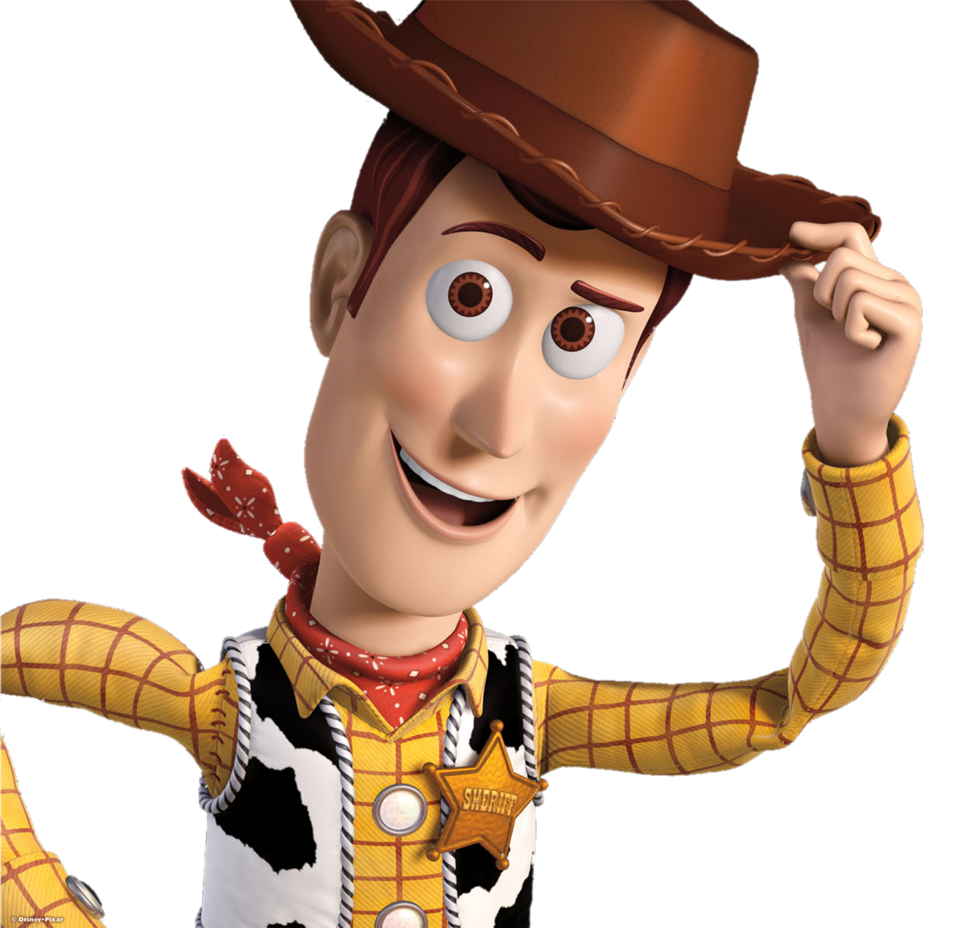
Notes:
“Like Joy, I love positive energy high fives and friendly smiles , so lets go around the room, say howdy and introduce yourselves! Don’t forget how old you are and maybe even your favorite movie character! I’m so happy you are all part of this ’round up!”

Slide 4
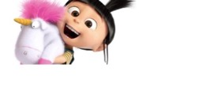
Class Rules:
Listen
Walk
Ask
Be kind
Notes:
(After students have converse with one another, answer any questions they may have about yourself... Make them comfortable, the first day should be fun!)
“Who has rules at home? We all know that the Minions had rules to follow or things went crazy! Listen to directions. We must always walk in the classroom to keep us safe, ask to get up from your tables, leave the room or to use the bathroom, and to be as kind as Agnus to her unicorns, making good choices for yourself and to your classmates.”
(After answering any questions the students may have, include that these rules will be posted by the morning group area to help them remember throughout the year.

Slide 5
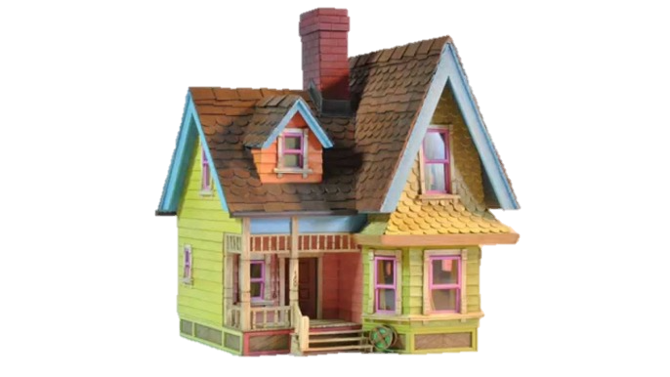
Earn your balloons and soar!
Notes:
Describe the desired behaviors to the students and remember to tell them that not only does their behavior affect them but the class as a whole. We are a team after all! Describe the giving/taking away of balloons on the ‘Up’ house, each day they will start out with 7 balloons and it takes 12 to fly away into the land of positive praise and rewards! I will give the student the option to have their ‘house’ reward at their desk or in the front of the classroom: this way they have the choice of where they will need their ”behavior chart” to achieve ‘balloons!’ I want to stress that some students may feel embarrassed or frustrated if their behavior is for the entire class to see; however, some may want theirs up there for the challenge and the responsibility to earn balloons for their house. Students that have a bad morning but good afternoon can have chances to add balloons to ‘soar’ instead of being stuck ’on the ground’ with no balloons at all! I will have my own private calendar that will collect the students’ data daily, so if any students have any “popped balloon’ days or negative behaviors, parents may be contacted and I will have the data to show. Rewards for these soaring houses can be tangible rewards, extra recess time, a ’my favorite tshirt day,’ etc.

Slide 6
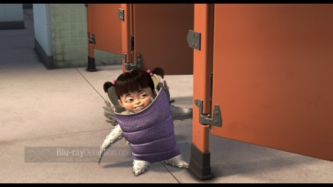
Enter the classroom
with walking feet and scare-floor noise level
Using the restroom
doesn’t need a dance, just ask!
Getting attention
Don’t get scary,
raise your hand
Notes:
Describe the procedures of the classroom:
Entering the classroom
Using the restrooms: all students must ask to leave the classroom and use the restroom, talk about the importance of washing hands
Turning in assignments and homework: students will go into their individual boxes to keep things organized, once they are done with their work they can get up and turn it in, then return to their desk to color or read a book that is at their desk to avoid unnecessary traffic
Gaining teacher attention: Tell students to always raise their hand to ask the teacher a question. We want our classroom at a scare-floor noise level! Remember to be patient and wait your turn

Slide 7
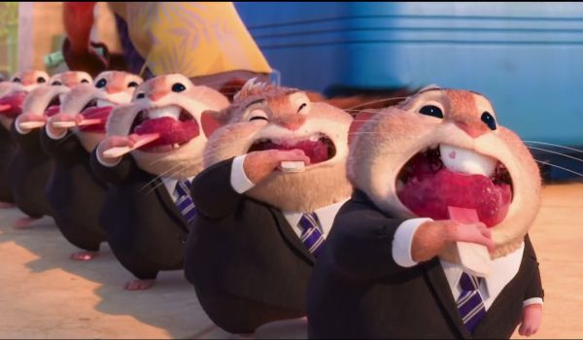
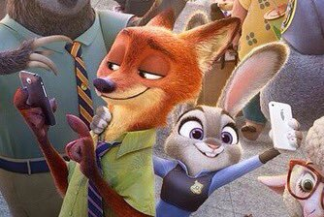
Food in the room
The lunchroom is your place to eat,
berries and nuts, all kinds of treats
Devices in the room
No electronic devices will be needed, we’ll use our brain power to solve cases like they did
Notes:
Food in the classroom: explain to students that food attracts bugs and could make messes, in addition to any allergies that the students may or may not have. Make it important to talk about food allergies and the safety measures to keep everyone safe.
Technology in the classroom: Gaming, phone, or any other type of device are not allowed in the classroom. Student laptop or class computers may be provided but they are in the class for learning purposes. Inform the students that a warning will be issued if they bring a device into the classroom, if it is seen again, the teacher will have to hold onto it the rest of the day.

Slide 8
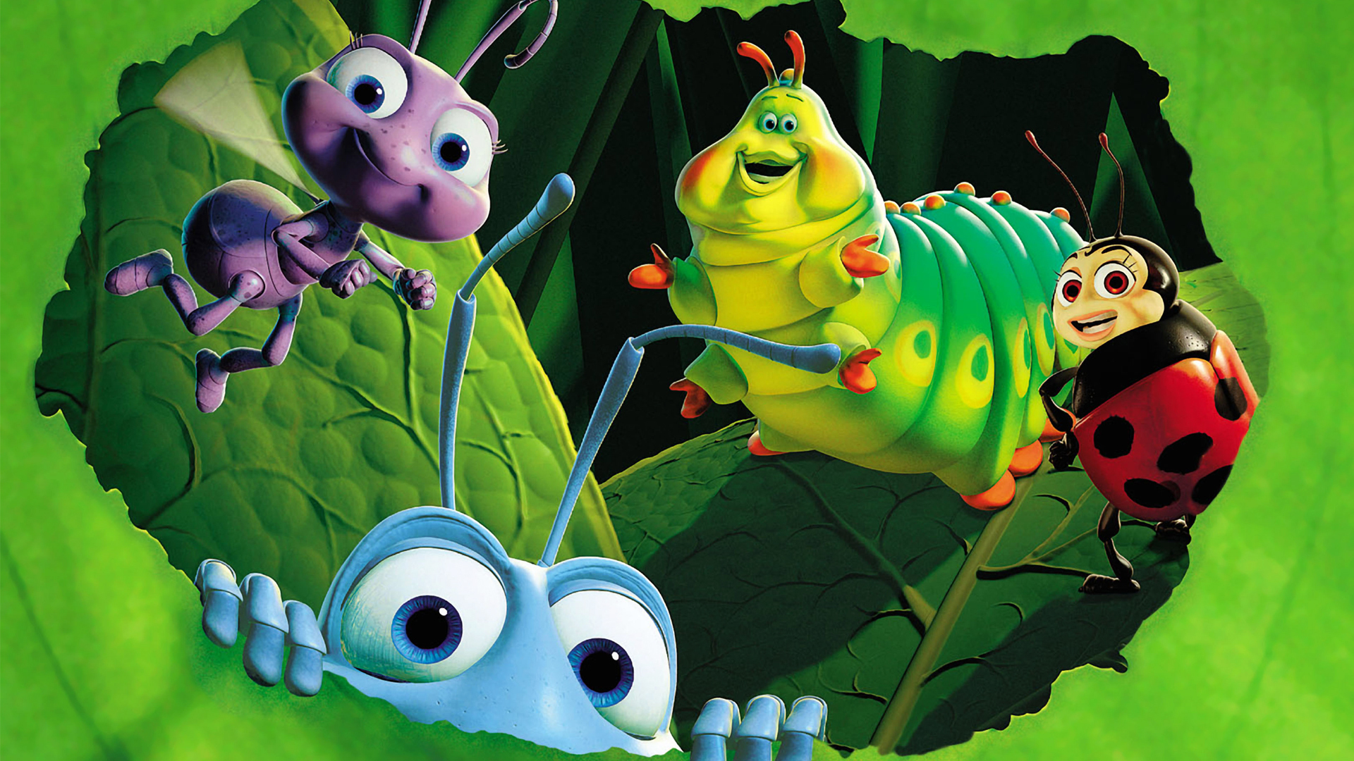
Notes:
“Look around the room, who sees anyone that looks just like you? How about who wears the same glasses as you, or who here brought the same lunch? If any of you have seen A Bugs Life, you know how many different characters use their special talents to work together. Each of you are special and may learn differently, can’t eat certain foods or need extra help to learn than the person sitting next to you. Remember to treat each other with kindness and celebrate your differences! There are millions of bugs but only one you!”

Slide 9
Celebrate your background, skills & abilities!
Notes:
At this time, students will maybe notice the differences between them and their peers. Explain to them as their teacher, I am here to help! Changing letters to different languages, giving time for extra help, using group work and collaboration to strengthen weaknesses and highlight strengths, guided reading groups, etc. If a lot of diversity appears in my classroom, I will briefly discuss a time in the year where we will celebrate the different holidays of the students in the class, with food, trinkets, videos, music, and more. I also want to review each students’ needs in the classroom and let them know that there are modifications or flexible options to further their learning, flexible seating for example.

Slide 10
The gang’s all here!
Notes:
“Look at all those toys, who work together as a team to solve problems! That is how I want our classroom to be. Like each toy, we all have different backgrounds that make us special, so it is important to ’be a friend’ to one another! It may be new to you, so if you have a question, ask but be kind and respectful! Some students may have a different language like the Aliens, others may not talk much at all like good old Bullseye, and maybe the person sitting next to you comes from a different place like Buzz Lightyear. If we have a classroom that values each of our differences, we will go ‘to infinity and beyond!’

Slide 11
BE INCREDIBLE!
Notes:
Explain to students that when they have balloons taken away for undesired behaviors or if they have a ‘popped balloon’ day, that I will be in contact with their parents to talk about their day. I will send home communication binders if requested or as needed, and send classroom news letters every 3-6 weeks, or as needed. It is important to have a strong but positive relationship with the parents of students and to encourage the same between parent and student. As a fun activity to spread throughout the year, I will communicate with parents or guardians and have them pick a day to come in, secretively! They will send in fun facts about their child throughout the day to see if the class can guess, then the parent or guardian will surprise the class and bring the student’s favorite book and read it to the class. I want to include parents/guardians as much as possible to help maintain a collaborative relationship with them and allow time in the educational setting with their child.
“Lets have an incredible year!”

